Slide 1


Cissey BELLO
28/11/2025

Slide 2

Outline
Executive Summary
Introduction
Methodology
Results
Conclusion
Appendix

Slide 3
Executive Summary
Data collection methodology:
Data was collected Using the SpaceX API and Web Scraping Launch Records from Wikipedia
Perform data wrangling
Data wrangling was performed by loading the raw dataset, identifying missing values, categorizing feature and analyzing outcome patterns
Perform exploratory data analysis (EDA) using visualization and SQL
Perform interactive visual analytics using Folium and Plotly Dash
Perform predictive analysis using classification models
Normalize and Split Data, Tune the parameters to fine the best (Grid search), Train the model and Evaluation (Confusion Matrix)

Slide 4
Introduction
Project background and context
The commercial space industry is rapidly evolving, with private companies making space travel and satellite deployment more accessible and affordable. Among the leading innovators is SpaceX, whose Falcon 9 rocket drastically lowers launch costs through its ability to reuse the first-stage booster. Since this booster represents the most expensive part of the rocket, its recovery significantly impacts the economics of a mission.
Problems you want to find answers
How does SpaceX achieve lower-cost launches?
What factors influence first-stage landing success?
Can we predict whether the Falcon 9 first stage will land?
How can predicted landing outcomes help estimate launch costs?

Slide 5

Section 1

Slide 6
Methodology
Executive Summary
Data collection methodology:
Data was collected Using the SpaceX API and Web Scraping Launch Records from Wikipedia
Perform data wrangling
Data wrangling was performed by loading the raw dataset, identifying missing values, categorizing feature and analyzing outcome patterns
Perform exploratory data analysis (EDA) using visualization and SQL
Perform interactive visual analytics using Folium and Plotly Dash
Perform predictive analysis using classification models
Normalize and Split Data, Tune the parameters to fine the best (Grid search), Train the model and Evaluation (Confusion Matrix)

Slide 7
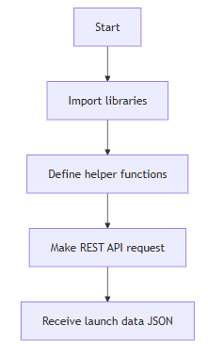
Data Collection – SpaceX API
To see SpaceX API notebook (GitHub) click here Link
Set up environment for REST API communication and data processing
Prepare functions for extracting detailed rocket, payload, launch site, and core information via REST calls
Request bulk launch records from SpaceX API
Convert API response to pandas DataFrame for data manipulation

Slide 8
Data Collection - Scraping
To see Web scraping notebook (GitHub) click here Link
Import libraries
Target the URL & GET request
Extract the target Data
Save
Parse
Set up environment for scraping communication and data processing
Target the Wikipedia URL and Make HTTP GET request (simulate browser)
Parse returned HTML for tables
Extract headers and initialize storage, Iterate over rows, clean and parse values
Store results and convert to DataFrame

Slide 9
Data Wrangling
To see Web Wrangling notebook (GitHub) click here Link
Summary of Data Wrangling Process (SpaceX Falcon 9 Dataset)
Installed and imported required libraries (pandas, numpy) for data processing.
Loaded the raw dataset using Pandas and previewed its structure.
Checked for and calculated missing values in every feature to assess data completeness.
Classified columns into categorical and numerical types for targeted analysis.
Explored launch sites and orbit types using value counts to understand their distributions.
Examined landing outcomes, categorizing them as "successful" or "unsuccessful."
Created a binary label (Class) for each launch: 1 for successful landings and 0 for failures.

Slide 10
EDA with Data Visualization
To see EDA with Data Visualization notebook (GitHub) click here Link
FlightNumber vs PayloadMass (sns.catplot, hue=Class)
To visualize how payload sizes vary over the launch timeline and whether success correlates with flight experience or payload mass.
FlightNumber vs LaunchSite (sns.catplot, hue=Class)
To see launch-site activity over time and compare success rates per site across launches.
PayloadMass vs LaunchSite (sns.catplot, hue=Class)
To inspect whether certain sites are used for heavier/lighter payloads and whether payload mass relates to success per site.
Success rate by Orbit (sns.barplot on grouped mean Class)
To quantify and compare landing success rates across orbit types (aggregated summary rather than point-level plotting).
FlightNumber vs Orbit (sns.catplot, hue=Class)
To check whether the relationship between flight experience (FlightNumber) and success differs by orbit type.
PayloadMass vs Orbit (sns.catplot, hue=Class)
To explore whether payload mass distributions differ by orbit and whether heavier/lighter payloads show different success patterns per orbit.

Slide 11
EDA with SQL
To see EDA with SQL notebook (GitHub) click here Link
Dropped and recreated SPACEXTABLE from SPACEXTBL excluding rows with NULL Date.
Queried DISTINCT Launch_Site → CCAFS LC-40, VAFB SLC-4E, KSC LC-39A, CCAFS SLC-40.
Selected 5 rows WHERE Launch_Site LIKE 'CCA%' (sample records from CCA* sites).
SUM(PAYLOAD_MASS__KG_) WHERE Customer='NASA (CRS)' → 45596.
AVG(PAYLOAD_MASS__KG_) WHERE Booster_Version='NASA (CRS)' → 2928.4 (possible filtering mistake: Customer used in place of booster name).
MIN(Date) WHERE Landing_Outcome LIKE '%ground pad%' → 2015-12-22.
SELECT Booster_Version WHERE Landing_Outcome='Success (drone ship)' AND payload BETWEEN 4000 AND 6000 → four boosters (e.g., F9 FT B1022, B1026, B1021.2, B1031.2).
COUNT(*) GROUP BY Mission_Outcome → mission counts (e.g., Success 98, Failure (in flight) 1, plus variants).
SELECT Booster_Version WHERE PAYLOAD_MASS__KG_ = (SELECT MAX(...)) → all boosters that carried the maximum payload.

Slide 12
Build an Interactive Map with Folium
To see Interactive Map with Folium notebook (GitHub) click here Link
folium.Map
Centered on NASA Johnson Space Center (29.5596849, -95.0830972) with a chosen zoom level.
Purpose: provides the basemap and initial geographic context so all markers/circles are displayed in relation to a familiar reference point.
Circle + Marker + Popup at NASA JSC
folium.Circle at the NASA coordinate (radius=1000, color='#d35400', fill=True).
folium.map.Marker with a DivIcon text label "NASA JSC".
Popup attached to the circle showing the site name.
Purpose: highlight the reference location, make it easily clickable (popup) and labeled on the map.
For each launch site (looping over launch_sites_df) I added:
folium.Circle(site_coord, radius=1000, color='#ffff00', fill=True) with a folium.Popup(site_name) To give a visible area around each launch site

Slide 13
Build a Dashboard with Plotly Dash
To see Dashboard with Plotly Dash (GitHub) click here Link
Dropdown (site): lets you choose All or a specific launch site to focus the dashboard and drive the charts for comparison or drill-down.
Pie chart: for "All" shows total successes by site; for a specific site shows success vs failure — provides a quick high-level distribution.
Payload RangeSlider: filters launches by payload mass to isolate effects of payload range on outcomes.
Scatter plot: payload vs outcome (class), colored by booster category with hover showing site — reveals payload–outcome and booster-related patterns under current filters

Slide 14
Predictive Analysis (Classification)
To see Predictive Analysis notebook (GitHub) click here Link
Import libraries
Define helper function
Models Building
Model Evaluation
Prepare Data
Set up environment for modelling and evaluate the model
Build a function to evaluate the model prediction (Confusion matrix)
Normalize and Split Data (Train and Test)
Tune the parameters to fine the best (Grid search), and Train the model
Predict on the test data and Evaluate with Confusion Matrix

Slide 15
Results
Exploratory data analysis results
Interactive analytics demo in screenshots
Predictive analysis results

Slide 16

Section 2

Slide 17
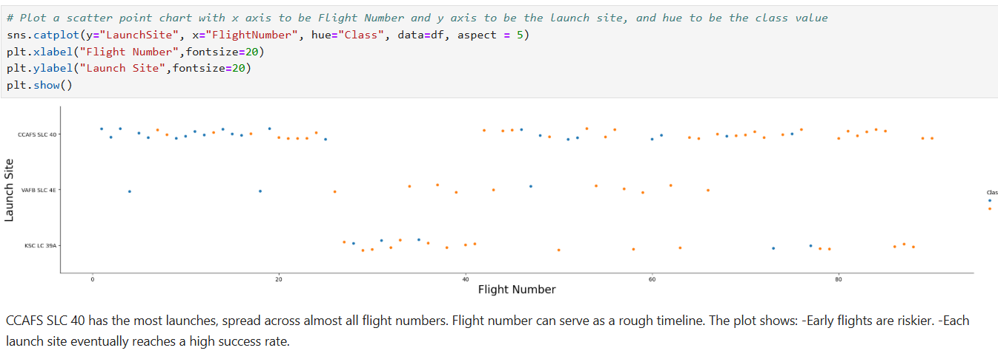
Flight Number vs. Launch Site

Slide 18
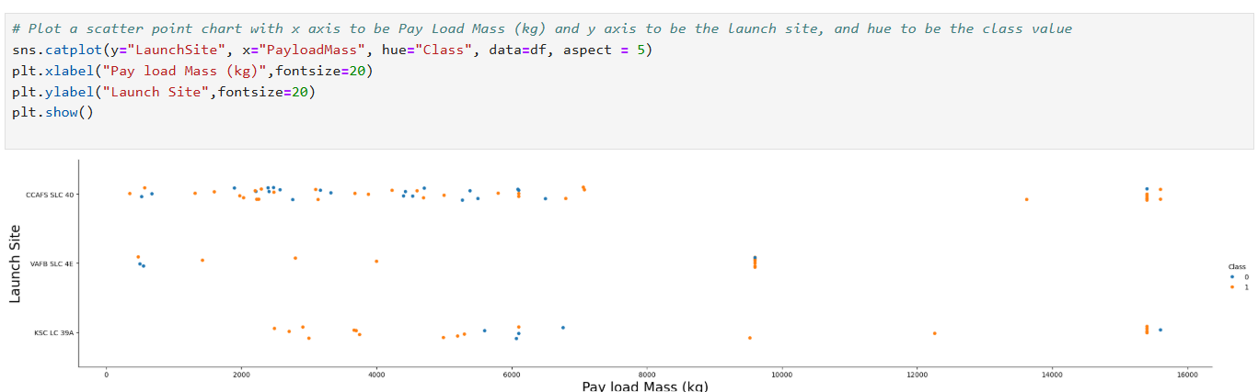
Payload vs. Launch Site

Slide 19
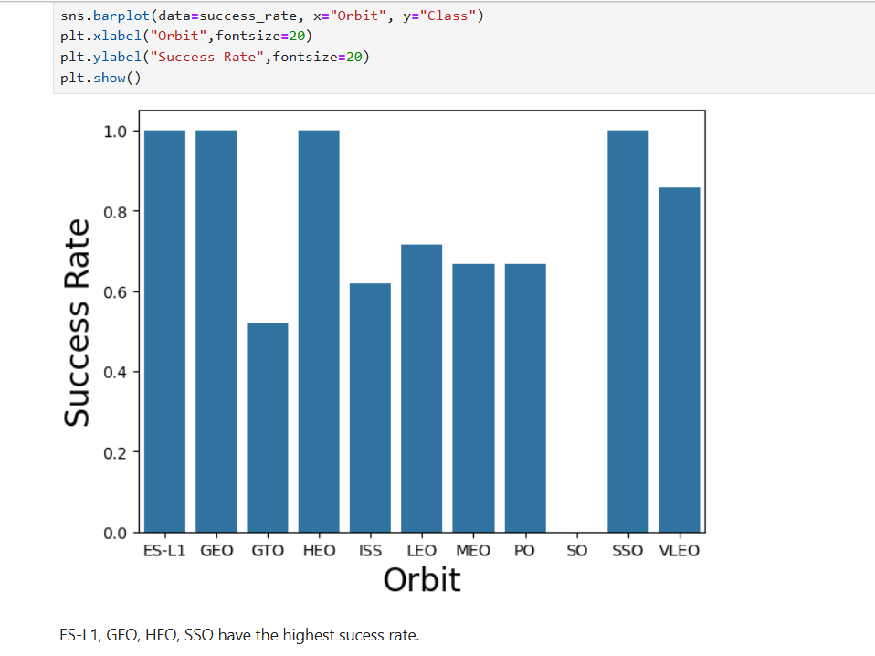
Success Rate vs. Orbit Type

Slide 20
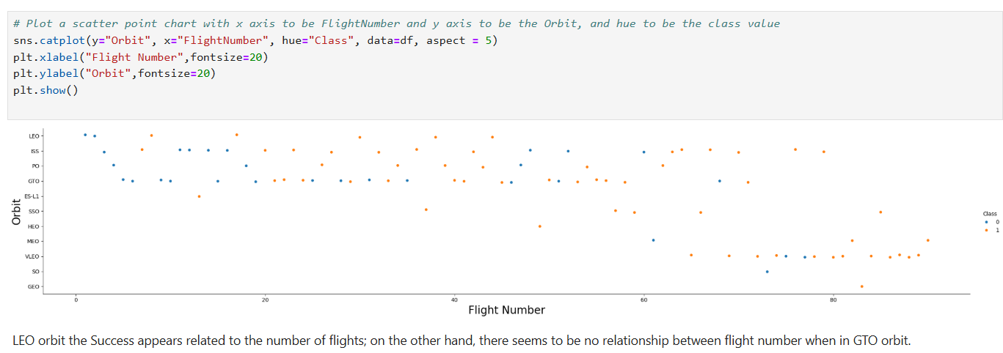
Flight Number vs. Orbit Type

Slide 21
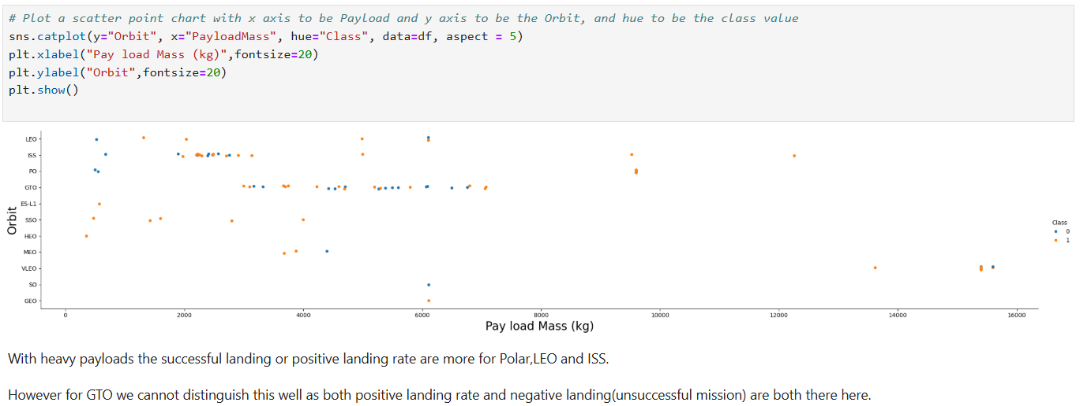
Payload vs. Orbit Type

Slide 22
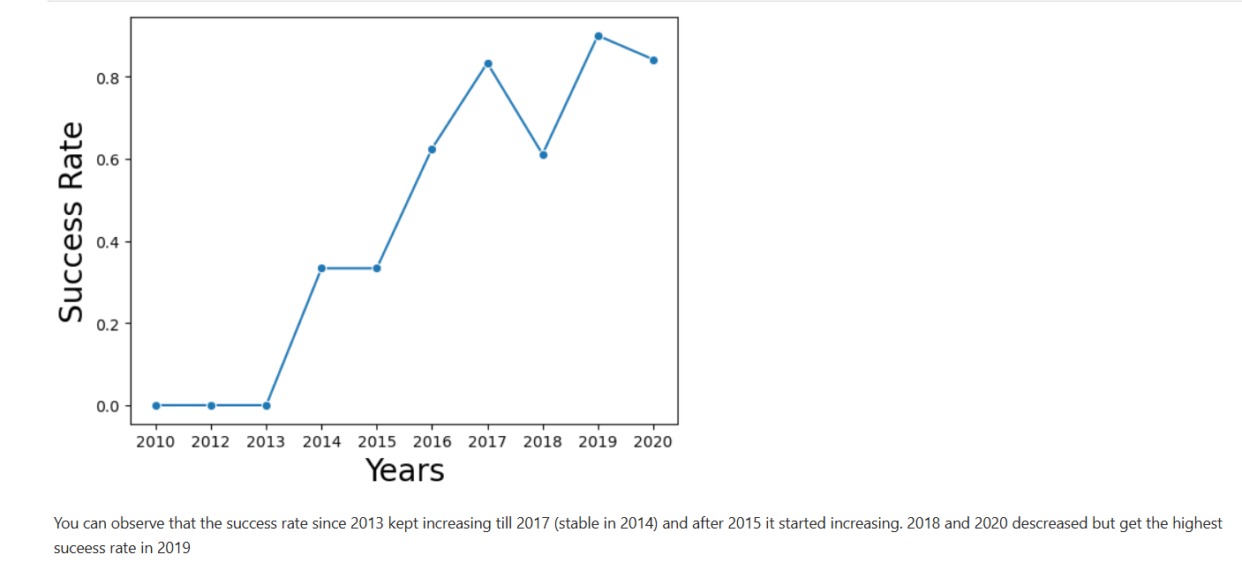
Launch Success Yearly Trend

Slide 23
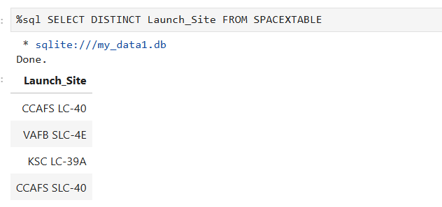
All Launch Site Names
Distinct allow to retrieve unique Launch Site in The SPACEX Table

Slide 24
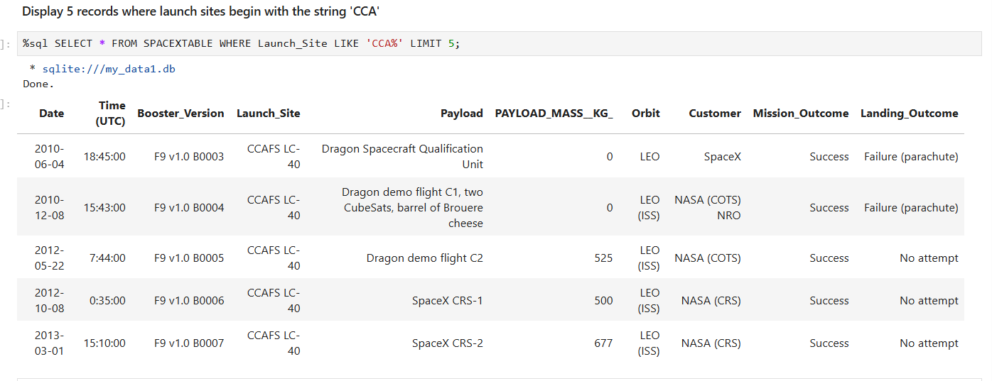
Launch Site Names Begin with 'CCA'

Slide 25
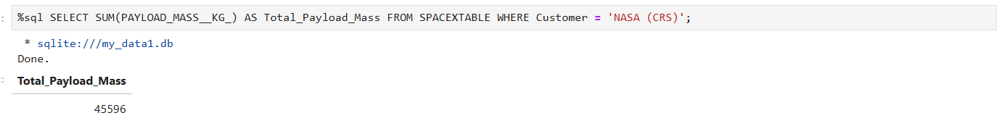
Total Payload Mass
Summarize the total payload Mass carried by boosters from NASA
To get the result use the function SUM and filter with customer = `NASA (CRS)´

Slide 26
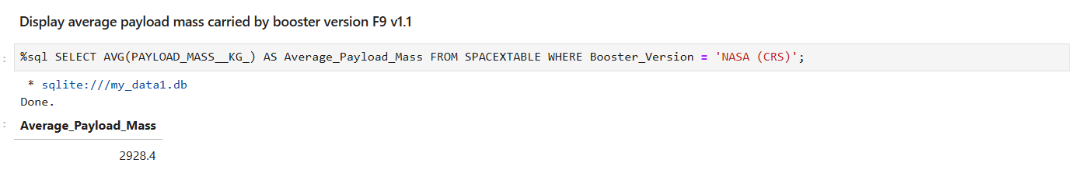
Average Payload Mass by F9 v1.1

Slide 27
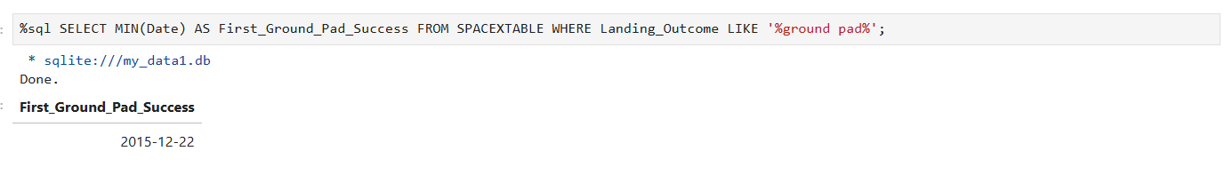
First Successful Ground Landing Date

Slide 28
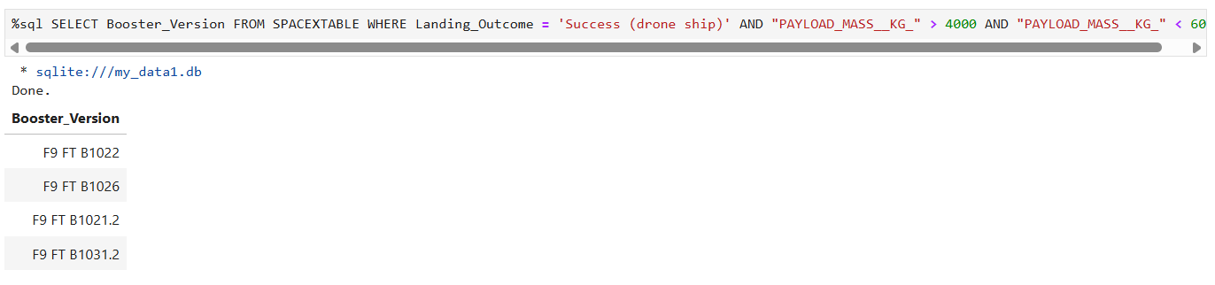
Successful Drone Ship Landing with Payload between 4000 and 6000
List the names of boosters which have successfully landed on drone ship and had payload mass greater than 4000 but less than 6000

Slide 29
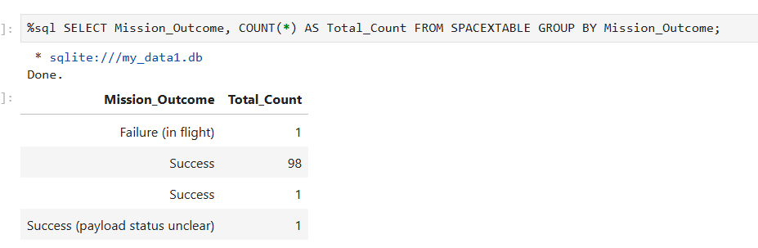
Total Number of Successful and Failure Mission Outcomes
Calculate the total number of successful and failure mission outcomes

Slide 30
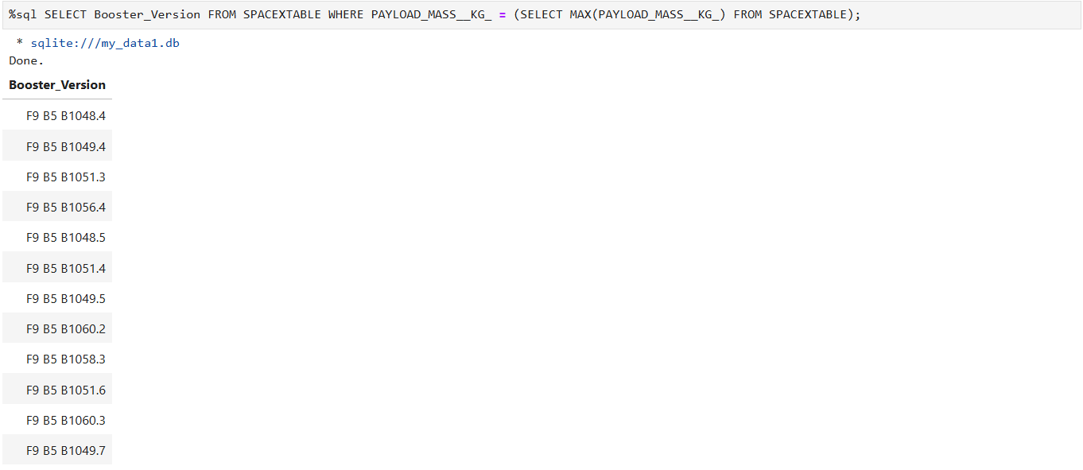
Boosters Carried Maximum Payload
List the names of the booster which have carried the maximum payload mass

Slide 31
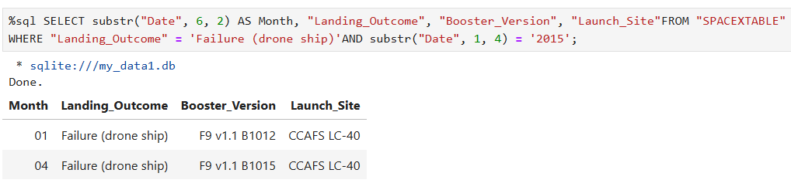
2015 Launch Records
List the failed landing_outcomes in drone ship, their booster versions, and launch site names for in year 2015

Slide 32
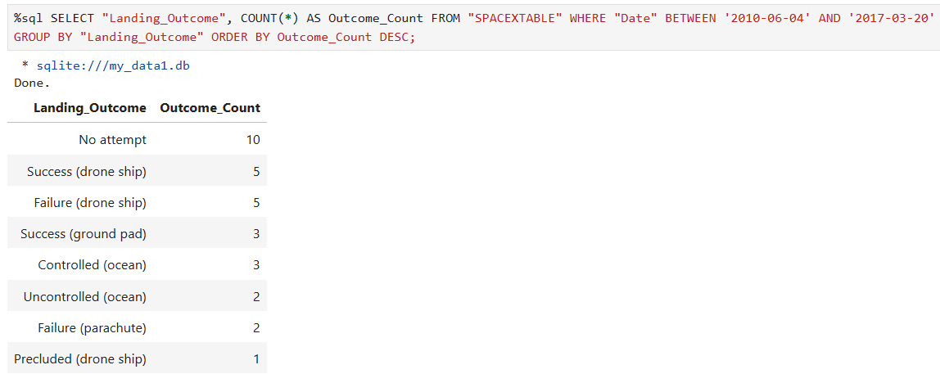
Rank Landing Outcomes Between 2010-06-04 and 2017-03-20
Rank the count of landing outcomes (such as Failure (drone ship) or Success (ground pad)) between the date 2010-06-04 and 2017-03-20, in descending order

Slide 33

Section 3

Slide 34
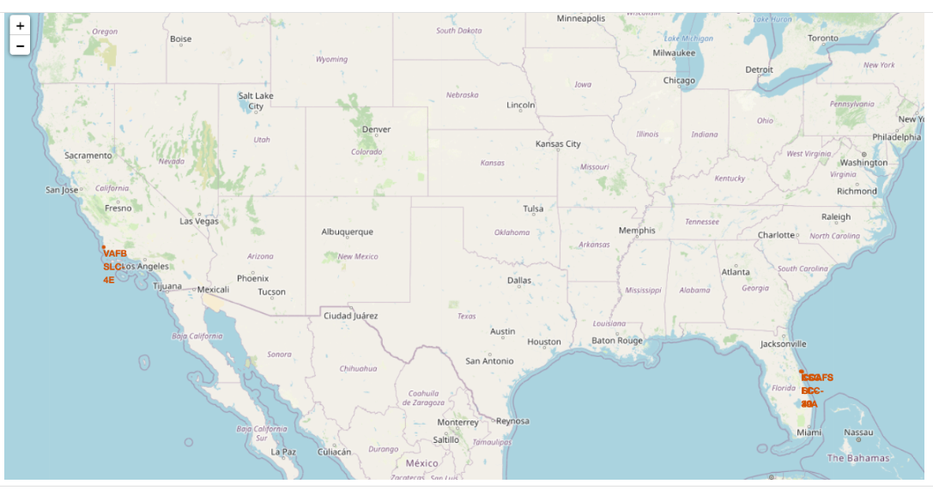
Launch sites 'location
Only VAFB SLC-4E site is on the west coast of US. The rest is on the East coast

Slide 35
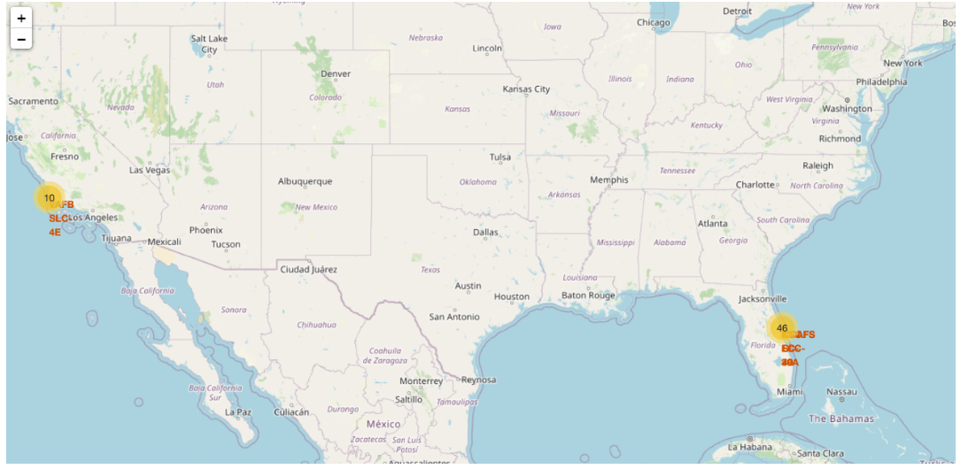
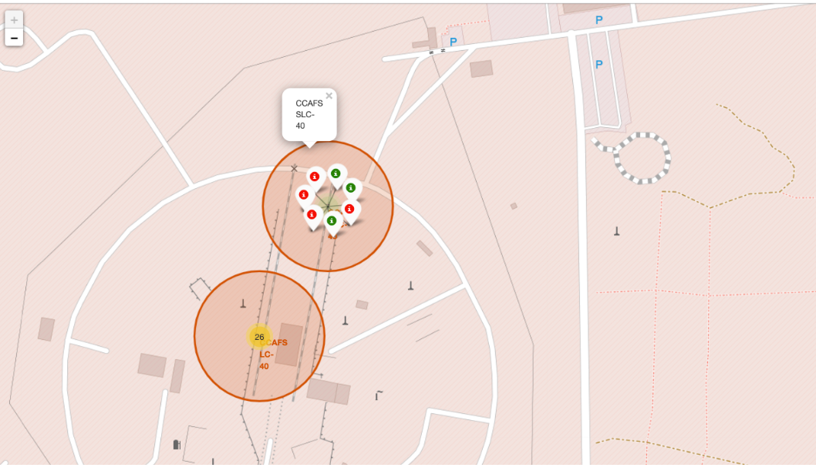
Success/failed launches for each site

Slide 36
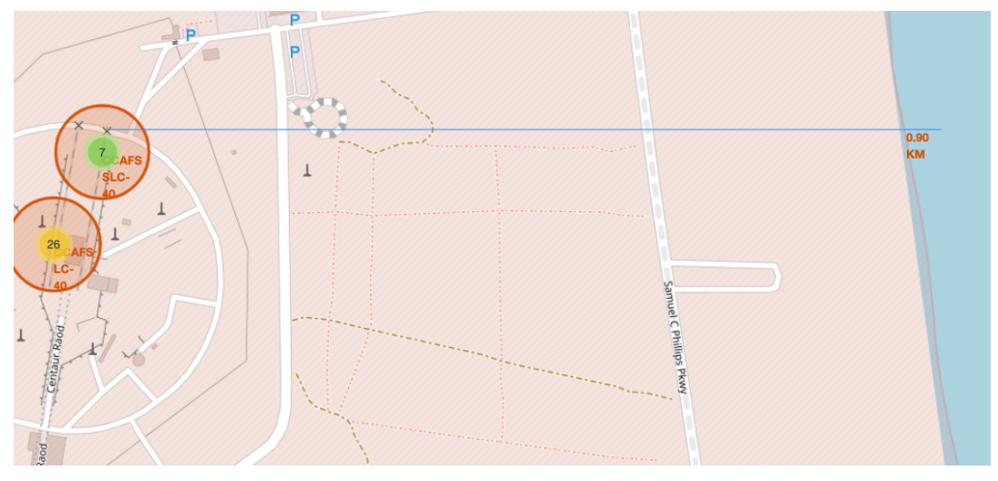
Distances between a launch site to its proximities

Slide 37

Section 4

Slide 38
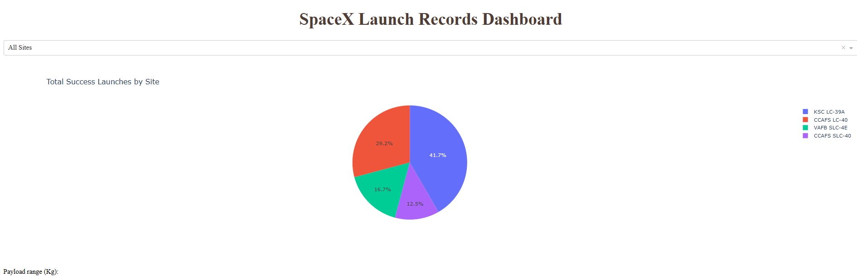
Launch success count for all sites
KSC LC 39A is the best Launch site with the success rate

Slide 39
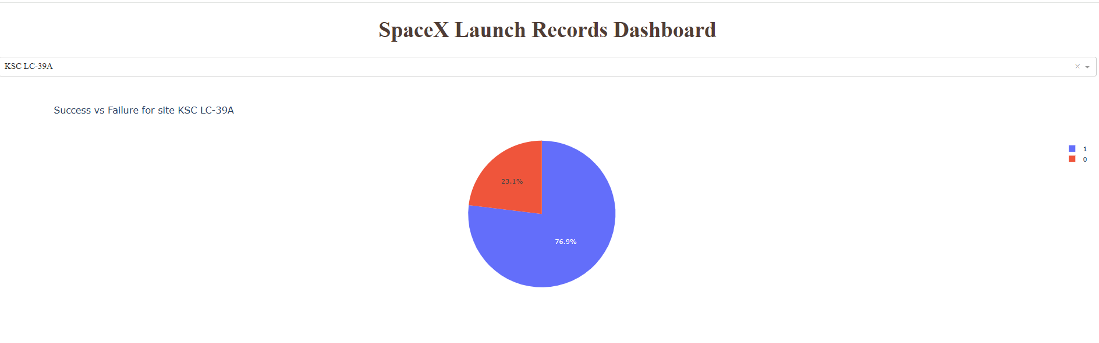
Success vs Failure for site KSC LC 39A
Success rate is 76.9% is the highest of all sites. That means 1 failed over 5 Launch

Slide 40
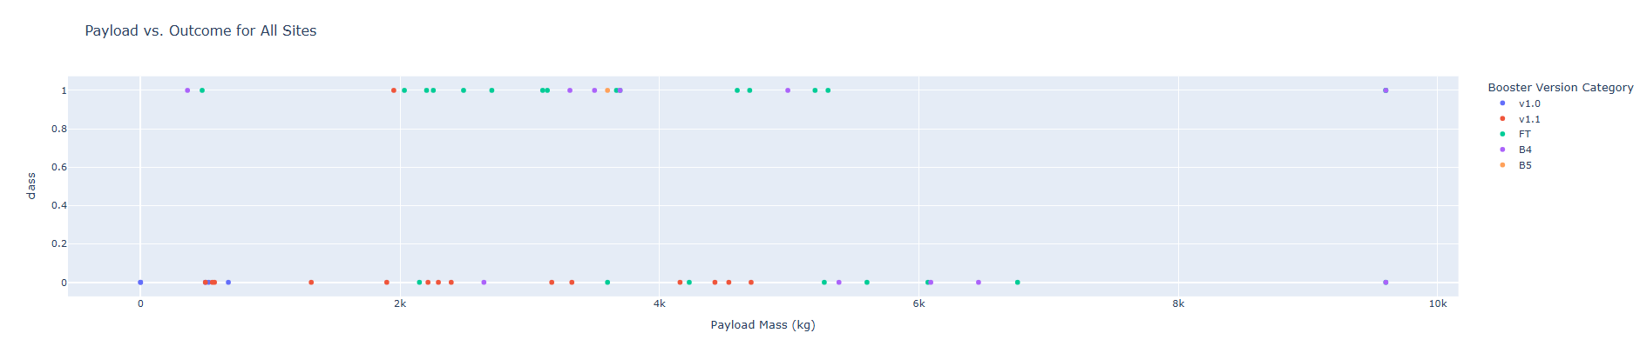
Payload vs. Launch Outcome for all sites

Slide 41

Section 5

Slide 42
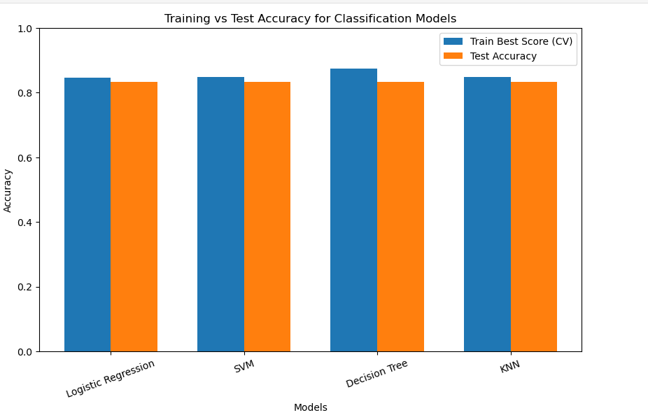
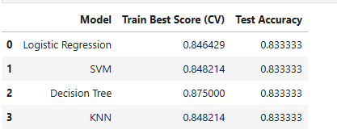
Classification Accuracy
Logistic Regression is the nearest predict score compare train to Test data

Slide 43
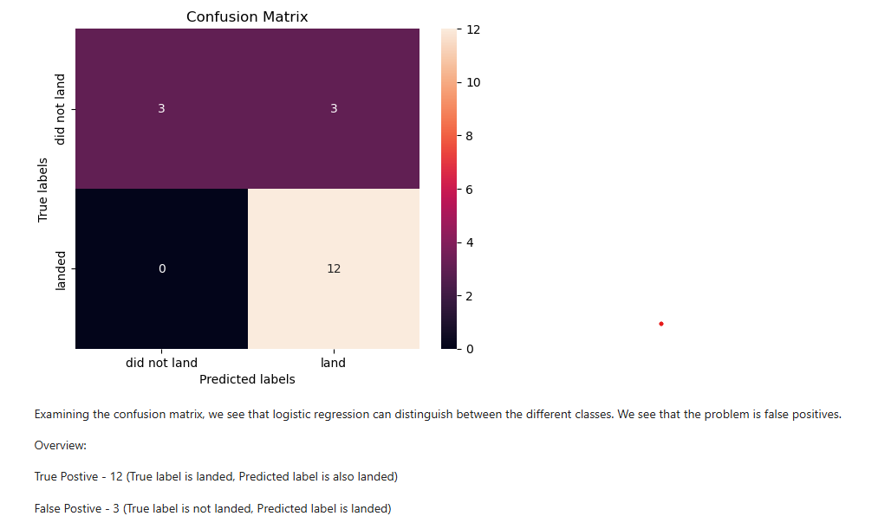
Confusion Matrix
The Best performing model(s) with accuracy 0.8333333333333334: ['Logistic Regression', 'SVM', 'Decision Tree', 'KNN']

Slide 44
Conclusions
4 disctint Launch sites
ES-L1, GEO, HEO and SSO Orbits got 100% success rate
KSC LC 39A is the best Launch site with the success rate
Logistic retrogression give the best model prediction between train and test data. It can be use for the predict the next launches

Slide 45
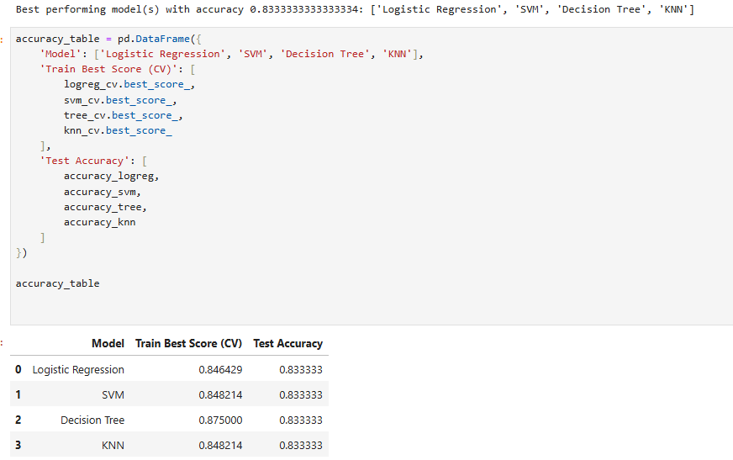
Appendix
Include any relevant assets like Python code snippets, SQL queries, charts, Notebook outputs, or data sets that you may have created during this project

Slide 46


